Slide 1

Web Scraping I

Slide 2
Motivation for Web Scraping
Relying on Downloadable CSV’s Puts You at a Disadvantage
Majority of Data Is Found Online
Negative: Online Data is Unstructured in HTML Format
Positive: Online Data is Often Updated, Relevant, & Untapped

Slide 3
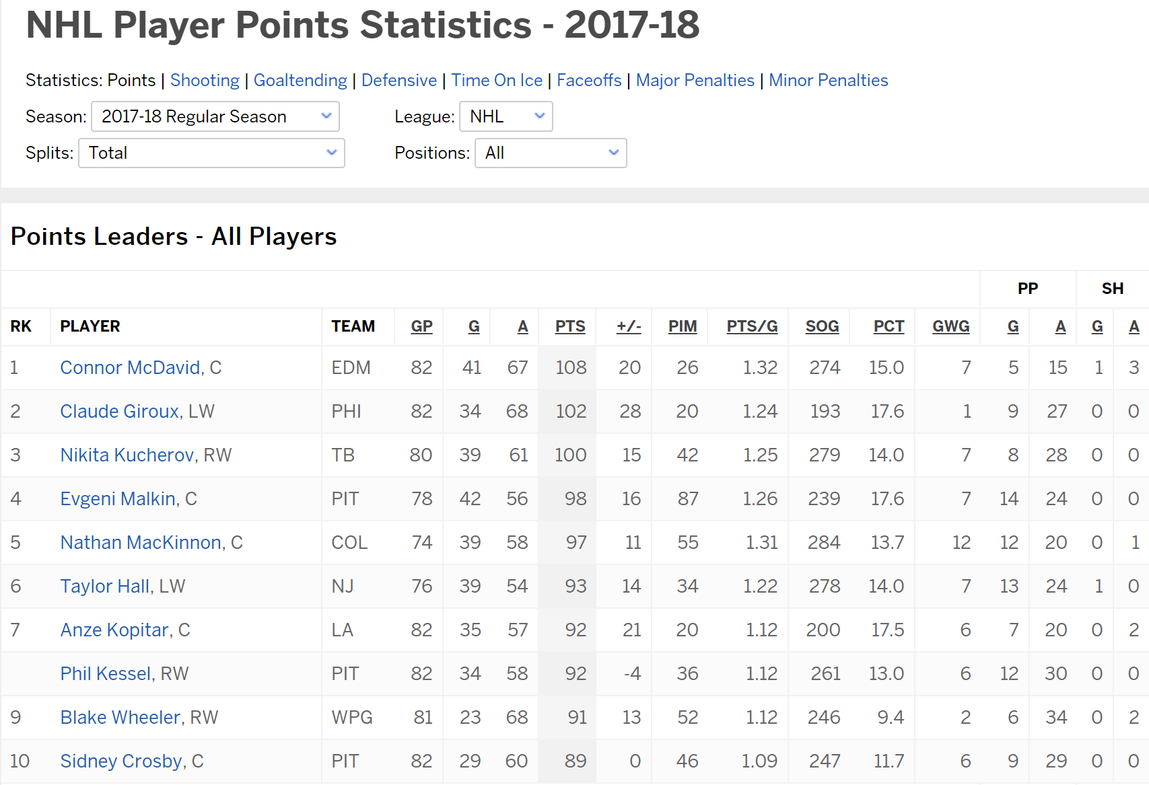
Motivation for Web Scraping
Example 1: ESPN NHL Stats

Slide 4
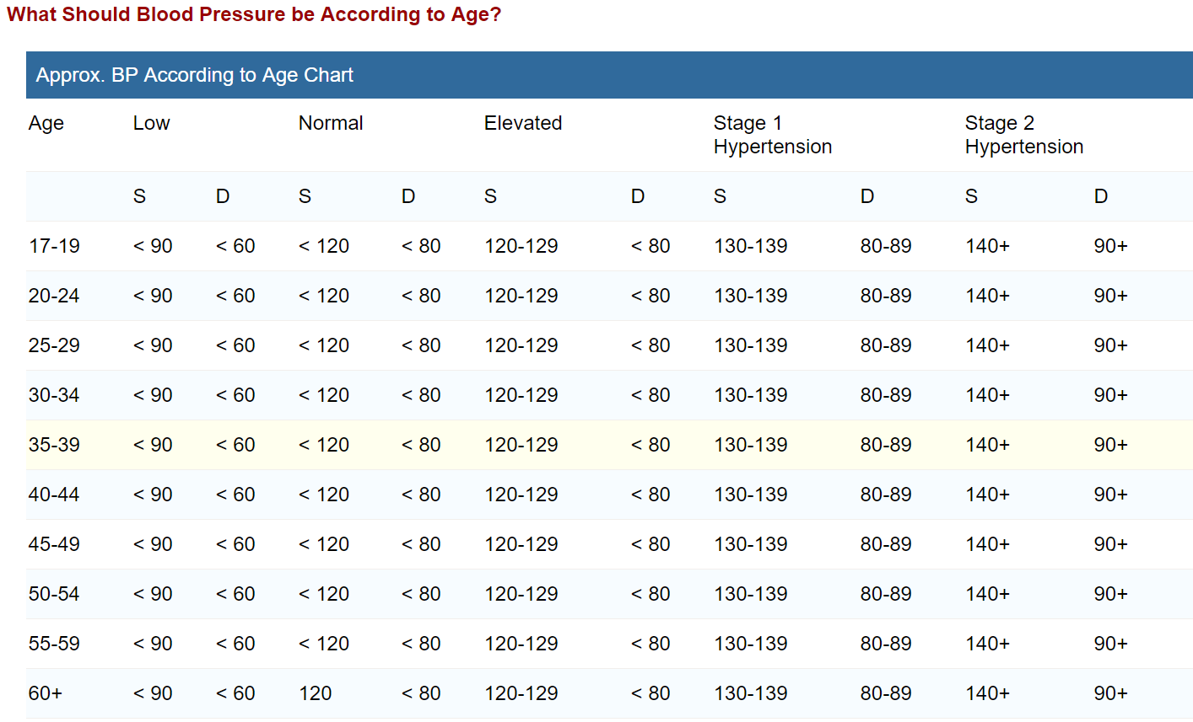
Motivation for Web Scraping
Example 2: Blood Pressure Chart

Slide 5
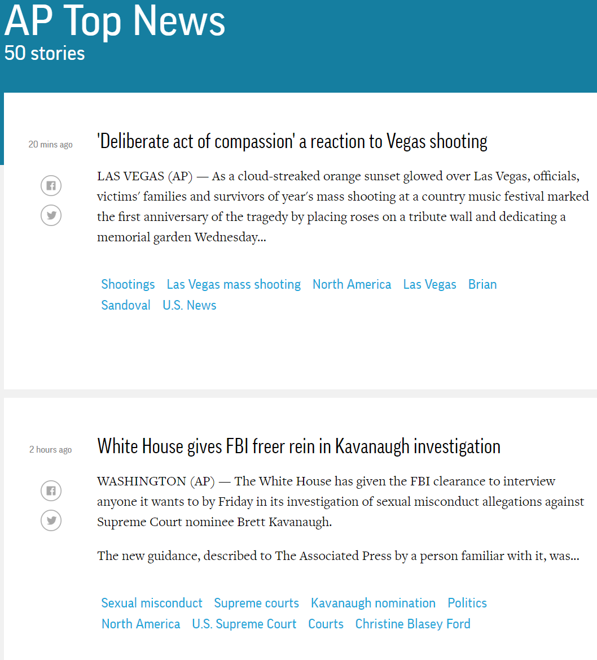
Motivation for Web Scraping
Example 3: AP Top 50 Stories

Slide 6
Web Scraping Defined
Process of Converting Currently Unstructured Data on Web to Structured Data in R
Ideas:
ESPN Table to CSV
Blood Pressure Chart to Tibble
Top News Stories to List in R
Absolutely Crucial Skill for Modern Data Scientists

Slide 7
Web Scraping in R
The rvest package
Written by Hadley Wickham
General Process:
> library(rvest)
Parse HTML
Extract Pieces You Want
Clean Information
URL

Slide 8
Tutorial 7 Introduction
Step 1: Open Tutorial 7
Step 2: Ensure You Have the Following R Packages Installed
tidyverse
rvest (Requires Internet)
noncensus
Step 3: Knit and Run
Step 4: Read the Introduction

Slide 9
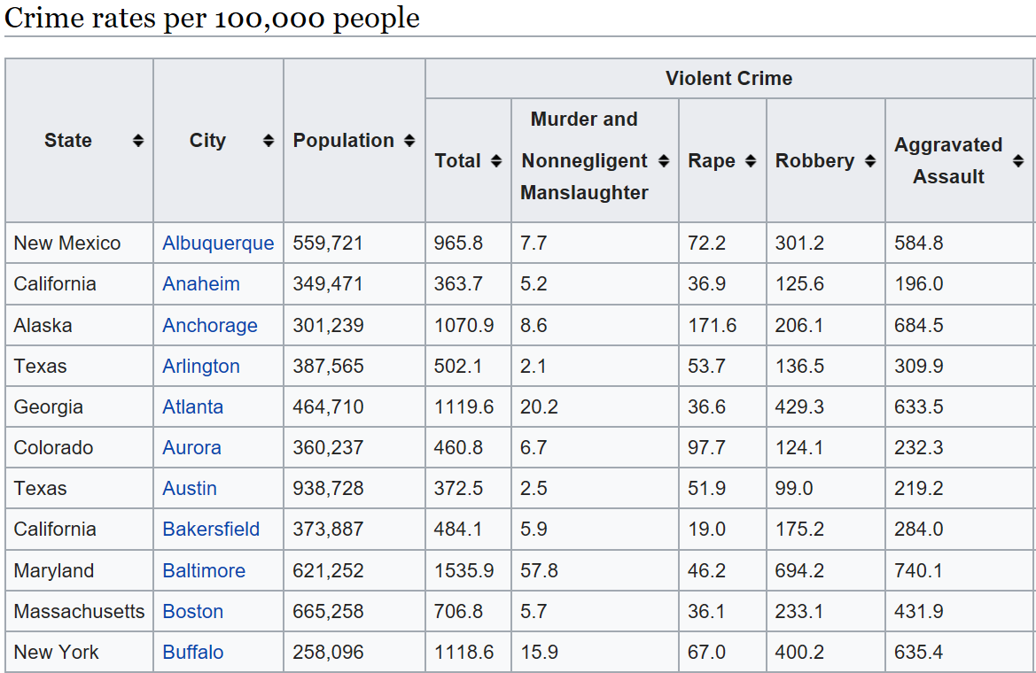
Part 1: Violent Crimes in US Cities
Step 1: Wikipedia Violent Crimes
Step 2: Locate the Table
Goal: Read Table Into R

Slide 10
Part 1: Violent Crimes in US Cities
Step 3: What Do You Expect to Be a Problem in the Data?
Step 4: Run Chunk 1
Is This What You Expected?
What New Problems Arise?
Step 5: Run Chunk 2
Select Wanted Information
Remove 1st Row – Subgroups
Rename Variables

Slide 11
Part 1: Violent Crimes in US Cities
Step 6: Run Chunk 3
Converting Variable Types
as.numeric()
as.character()
as.date()
as.integer()
Additional Problem in Population Variable
Step 7: Run Chunk 4
City Variable Has Problems
Why Do We Care?

Slide 12
Part 1: Violent Crimes in US Cities
Step 8: Run Chunk 5
String Functions Used
str_replace_all()
str_replace()
Conditional Mutation
ifelse()
Step 9: Base Knit

Slide 13
Part 2: Geographical Locations of US Cities
Step 1: What Additional Information Would We Need to Plot Crime Information on a Map?
Step 2: Run Chunk 1
What Info is Important?
What Do You Notice About the City Variable?
Step 3: Run Chunk 2
Goal: Find the Average Latitude and Longitude for Each City and State

Slide 14
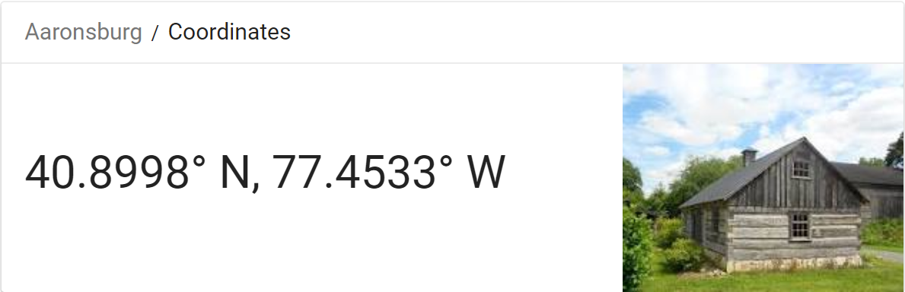
Part 2: Geographical Locations of US Cities
Step 4: Run Chunk 3
Examine the Output
Notice Aaronsburg, PA
Are We Ready to Merge?
#No
#WhyNot
Step 5: Pinch Knit

Slide 15
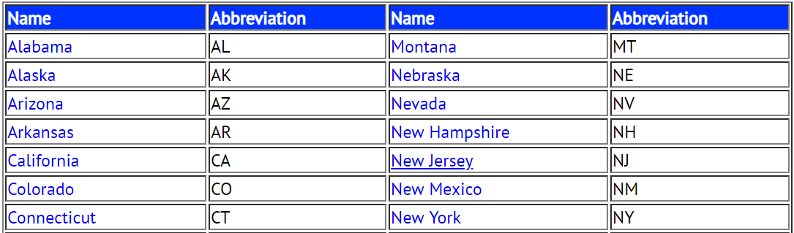
Part 3: Linking State Names to State Abbreviations
Step 1: Select Website Link
Step 2: Examine the Table
Step 3: What is the Issue with the Way this Information is Presented and How Does this Pose a Threat to Our Existence?

Slide 16
Part 3: Linking State Names to State Abbreviations
Step 4: Run Chunk 1
Did You Get What You Expected?
How Should We Fix This Data?
Step 5: Run Chunk 2
Stacking Datasets
Horizontally
Vertically
Step 6: Knitting Streak
> cbind(x,y)
> rbind(x,y)

Slide 17
Intermission
Final 3 Data Frames Should All Be Saved to CSV’s
We Will Begin the Last Half of This Tutorial By Loading in this Information
Think About What Other City Information Could Potentially Be a Factor in Violent Crimes
Think About What Other City Information Could Potentially Be Influenced by the Prevalence of Violent Crimes

Slide 18
Closing
Disperse and Make Reasonable Decisions

